Slide 1
Title of the training/session
Date + Name and email address of the trainer(s)
The project is co-funded by the Justice Program of the European Union (2014 – 2020)
Logo of your organisation
Notes:
Integrate the logo of your organisation on the left side of the CLEAR-Rights logo on each slide.

Slide 2
CLEAR-Rights
Objective: strengthen legal assistance for children suspected, accused or convicted of an offence and thus ensure that their rights are respected.
Capacity Building
Advocacy
Cooperation
The project is co-funded by the Justice Program of the European Union (2014 – 2020)
Logo of your organisation
Notes:
Children in conflict with the law (i.e. suspected, accused or convicted) are entitled to quality legal assistance. However, for many of them in Europe, it remains difficult to have access to it. Gaps in terms of availability, accessibility, acceptability, and adaptability of legal assistance have been identified during the review of the situation led in Belgium, France, Hungary, Romania, and The Netherlands during the first phase of the CLEAR-Rights project .
Based on these observations, the Clear Rights project aims to strengthen legal assistance for children suspected, accused or convicted of an offence and thus ensure that their rights are respected. In particular, the project aims to ensure that children in conflict with the law have free access to a lawyer or quality pro bono legal assistance whenever they need it.
With this project, we particularly want to :
Increase the capacity of legal practitioners, in particular legal aid and pro bono lawyers, to provide quality legal assistance to children suspected or accused of crime. (to achieve this, we organise trainings, developed some resource documents for lawyers, organise webinars etc.)
Improve cooperation between non-governmental organisations and professional organisations in the field of procedural rights of children suspected or accused of crime. (to achieve this, we will for example set up a national clearinghouse for child justice in Romania and reinforce the clearinghouse in France).
Increased awareness of policy makers and service providers on the right of children suspected or accused of crime to access quality legal assistance and benefit from a permanent legal assistance system.

Slide 3
European project
The CLEAR-Rights project is co-funded by the European Union’s Justice Programme (2014-2020). The content of this document represents the views of the authors only and their sole responsibility. The European Commission does not accept any responsibility for use that may be made of the information it contains.
Logo of your organisation
Notes:
The CLEAR-Rights project is a European Project, it is led by Terre des hommes Regional Hub in Hungary and implemented in partnership with Terre des hommes Romania, PILnet, Alliance of Lawyers for Human Rights (France), Defence for Children International (Belgium), Defence for Children The Netherlands. The project is co-funded by the European Union’s Justice Programme.
The trainer do not need to read the sentence regarding the responsibility of the European Commission, this is only a disclaimer we have to integrate in our written publications.

Slide 4
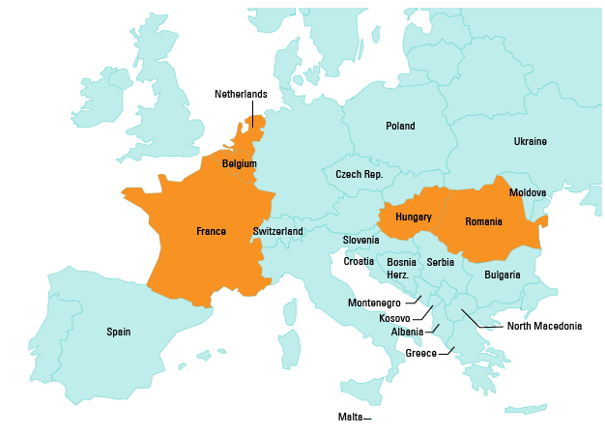
European project
The project is co-funded by the Justice Program of the European Union (2014 – 2020)
Logo of your organisation
Notes:
The project is being implemented in 5 EU countries: France, Belgium, The Netherlands, Hungary and Romania.

Slide 5
Many resources
A review of practices (in 5 EU countries)
Quality Standards for legal assistance for children suspected and/or accused – A step-by-step Guide
Accreditation Criteria
A Database of legal factsheets regarding the rights of children in conflict with the law, to support your legal work
A child friendly version of the Quality standards
The project is co-funded by the Justice Program of the European Union (2014 – 2020)
Logo of your organisation
Notes:
Here, I only mention some resources of the project, you can include references to others.
We already developed (or are about to develop) various resources you may find usefull in your job.
Before the training, the trainers should consult the page all available resources to discribe them to participants. The Review and the Quality Standards will, for sure, be published before the trainings, integrate the link into the ppt (they might also be already available in national languages).
For the other material, you can describe them as:
A review of practices in 5 EU countries : this review provide an overview of the different legal aid services offered to children in conflict with the law, with a specific focus on five countries: Belgium, France, Hungary, Romania and The Netherlands. Challenges and promising practices in accessing legal aid for children in conflict with the law, quality standards, capacities and training needs are identified. The European review is mainly based on a desk research and , field consultations with professionals in the five countries(focus groups, interviews and/or online questionaires).
Quality Standards for legal assistance for children suspected and/or accused – A step-by-step Guide : This document shall serve as a knowledge base to legal professionals. It contains: 14 Quality Standards (i.e. the code principles for a good legal assistance for chidren in conflict with the law such as: child-centred, safe and protective etc.) and a Step-by-step Guide with precise instructions for lawyers to follow on how to provide legal assistance to children. The Guide is designed as a tool that can be used short notice and that will guide a lawyer through the relevant phases of representing a child in conflict with the law
Accreditation Criteria : These Criteria designate the key criteria or requirements (education, work experience, etc.) that a lawyer should comply with for accreditation to provide legal assistance to children in conflict with the law in Europe.
And other practical tools such as :
an online database with facthseets providing key information of relevant international and national standards and jurisprudence related to children in conflict with the law, for example factsheets on the procedural rights of minors when they are in police custody etc. Some factsheets are available for Belgium, France, Romania, The Netherlands or Hungary.
A child friendly version of the Quality standards: children do not always know what they can expect from their lawyer, especially if he is pro bono or legal aid, this document help them understand what quality standards a lawyer should respect when assisting them. Also given that it will be developed based on what children said during consultations, this child friendly version can help lawyers understanding what children expect.

Slide 6
Agenda
The project is co-funded by the Justice Program of the European Union (2014 – 2020)
Logo of your organisation
Notes:
Include here the agenda of the training and explain it shortly to participants (including the relation and articulation of the modules).

